Slide 1
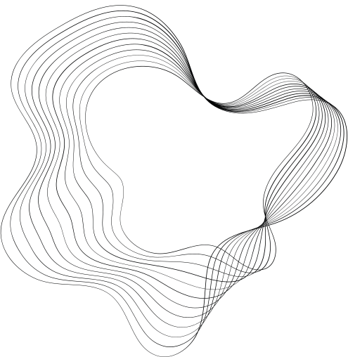

UNIVERSITY OF BASRAH / COLLEGE OF SCIENCE
LECTURE 5
FACTORS AFFECTING THE GROWTH AND SURVIVAL OF MICRO-ORGANISMS IN FOODS
Department of Pathological Analyses
Presented by Prof.Dr. Saad S. Mahdi Al-amaradi Al-Amara

Slide 2
Microbial Growth
  Growth is the increase in cellular components due to microorganisms reproducing through processes like budding or binary fission, resulting in two progeny of approximately equal size .
  Growth occurs when cells become longer or larger, especially in coenocytic microorganisms where nuclear divisions are not accompanied by cell divisions.
  Microbiologists typically study growth by tracking changes in the total population number, as individual microorganisms' growth and reproduction are not convenient to investigate.

Slide 3
Lag Phase
  The lag phase occurs when microorganisms are introduced into fresh culture medium, without immediate cell number increase.
  This period is necessary for various reasons, such as old cells depleted of ATP, essential cofactors, and ribosomes, or the medium being different from the previous one.
  The cells retool, replicate their DNA, increase in mass, and eventually divide. The length of the lag phase varies depending on the microorganisms' condition and the medium's nature.
  It may be longer if the inoculum is from an old or refrigerated culture, or if the culture is inoculated into a chemically different medium. However, when a young, vigorously growing exponential phase culture is transferred to fresh medium, the lag phase is short or absent.

Slide 4
Exponential Phase
  During the exponential phase, microorganisms grow and divide at their maximum rate, considering genetic potential, medium nature, and growth conditions.
  The growth rate remains constant, with each individual dividing at a slightly different moment.
  This phase results in a uniform population with uniform chemical and physiological properties, making it commonly used in biochemical and physiological studies.

Slide 5
Stationary Phase
  In the stationary phase of microbial growth, the total number of viable microorganisms remains constant, resulting from a balance between cell division and cell death or the population ceasing to divide while remaining metabolically active.
  This phase is usually reached by bacteria at a population level of around 109 cells per ml, while other microorganisms do not reach such high concentrations.
  Factors influencing the stationary phase include nutrient limitation, O2 availability, accumulation of toxic waste products, and Oxygen is not very soluble and may be depleted so quickly that only the surface of a culture will have an O2 concentration adequate for growth. .

Slide 6
  Nutrient depletion can slow population growth, while aerobic organisms may be limited by O2 availability, which can be depleted quickly, affecting growth.
  Toxic waste products can limit population growth in anaerobic cultures, For example as streptococci, which can produce lactic acid and other organic acids from sugar fermentation, leading to acidic medium and inhibited growth.
  Streptococcal cultures also can enter the stationary phase due to depletion of their sugar supply. Finally, there is some evidence that growth may cease when a critical population level is reached. Thus entrance into the stationary phase may result from several factors operating in concert.

Slide 7
Death Phase
  Environmental changes like nutrient deprivation and toxic waste buildup cause a decline in the number of viable cells in the death phase.
  The death rate is usually logarithmic, with a constant proportion of cells dying every hour.
  This pattern in viable cell count holds even when the total cell number remains constant because the cells simply fail to lyse after dying.
  Viability is determined by incubating bacterial cells in fresh medium. Death is defined as irreversible loss of reproduction ability.
  The death rate may decrease after drastic population reduction due to extended survival of resistant cells, making the death phase curve complex.

Slide 8
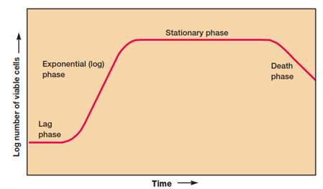

Slide 9
The Mathematics of Growth
  Growth rate studies are crucial for physiological and ecological research and solving industry problems.
  During the exponential phase, microorganisms divide at constant intervals, doubling in number during generation time or doubling time. For example, a culture tube inoculated with one cell divides every 20 minutes, resulting in a population increase of 2n, where is the number of generations.
  This exponential or logarithmic increase is essential for understanding biological processes.

Slide 10
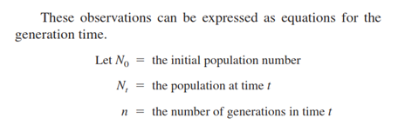

Slide 11
Intrinsic Factors (Substrate Limitations)
Nutrient Content
The Common Nutrient Requirements
In order to grow and function normally, the microorganisms of importance in foods require the following:
1. water
2. source of energy
3. source of nitrogen
4. vitamins and related growth factors
5. minerals

Slide 12
  Over 95% of microbial cell dry weight is composed of macroelements or macronutrients, including carbon, oxygen, hydrogen, nitrogen, sulfur, phosphorus, potassium, calcium, magnesium, and iron.
  These elements are required by microorganisms in large amounts. The first six macroelements are components of carbohydrates, lipids, proteins, and nucleic acids.
  The remaining four macroelements exist as cations and play various roles, such as requiring potassium for enzyme activity, contributing to heat resistance in bacterial endospores, and stabilizing ribosomes and cell membranes.

Slide 13
  All organisms, including microorganisms, require several micronutrients or trace elements besides macro elements. The micronutrients—manganese, zinc, cobalt, molybdenum, nickel, and copper—are needed by most cells.
  The inability of an organism to utilize a major component of a food material will limit its growth.
  Thus, the ability to synthesize amylolytic (starch degrading) enzymes will favor the growth of an organism on cereals and other farinaceous products.
  The addition of fruits containing sucrose and other sugars to yoghurt increases the range of carbohydrates available and allows the developmentof a more diverse spoilage microﬂora of yeasts.

